Slide 1

PIXIU
Xiao Zhang

Slide 2
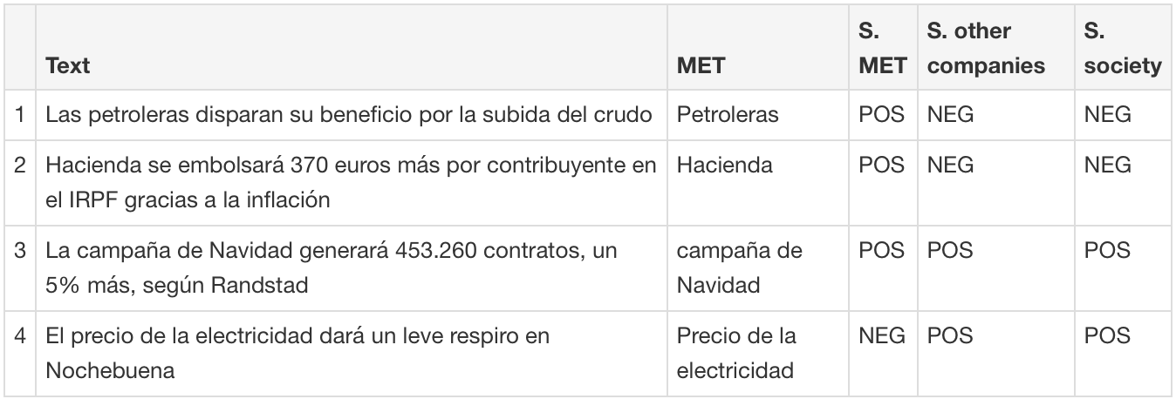
Spanish Datasets
1. Financial Exams conducted in Spanish
from European Financial Advisor (EFA)
(1) EFP.json 37 records choose from A,B,C
(2) EFPA.json 228 records choose from A,B,C, and D
{"query:": the instruction and all the details of the question,
Answer:", A or B or C,
"text": all the infromation about this quesiotn ,
"choices":["A", "B", "C"]
"gold":0 for A, 1 for B, and 2 for C }
(3) Sentiment Analysis dataset, 3828 records
https://peerj.com/articles/cs-1377/#supp-2%3E
2
Notes:
Point a has lower risk and lower return than Point b, but the utility of both points is the same because the higher return at Point b is offset by the higher risk.

Slide 3
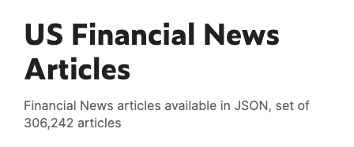
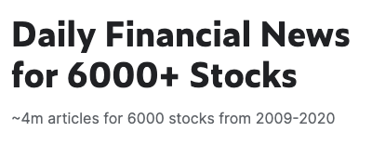

Spanish Datasets
1. Financial Exams conducted in Spanish
(4) text dataset labeled as “tax”, “technology”, “finance”, “government” ect. 4132 records
(5) dataset of summaries 182 records
(6) Kaggle
2
Notes:
Point a has lower risk and lower return than Point b, but the utility of both points is the same because the higher return at Point b is offset by the higher risk.

